Slide 1


Plotting coordinates generated from a rule
Task A: Finding a rule from a set of coordinates
For each set of coordinates, fill in the gaps to describe the relationship in words and using algebra:
(0,1) (2,3) (9,10)
The y coordinate is equal to the x coordinate .
(2,6) (-4,0) (4,8)
The y coordinate is equal to the x coordinate plus 4.
(10,5) (4,-1) (0,-5)
The y coordinate is equal to the x coordinate .
(-7,-2) (-3,2) (2.2,7.2)
The y coordinate is .
(2,4) (3,6) (8,16)
The y coordinate is .
(2,20) (-4,-40) (3,30)
The y coordinate is .
(0,0) (1,5) (-1,-5)
The y coordinate is .
(10,1) (6,0.6) (30,3)
The y coordinate is .

Slide 2




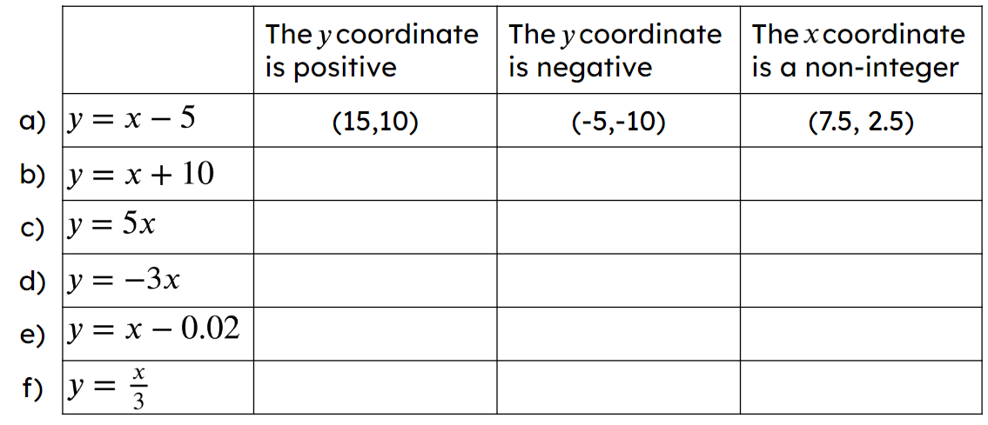
Plotting coordinates generated from a rule
Task B: Generating coordinates from a rule
Generate 3 coordinates that follow each rule. Some have the x or y coordinate already filled in.
( 3 , ) ( , ) ( , )
( 0 , ) ( , 9 ) ( , )
( 0 , ) ( ,300) ( , )
( 0 , ) ( , ) ( , )
Fill in the table with a different coordinate for the equation that satisfies each condition. The first one has been done for you.
Mathematics in Education and Industry
v2.1

Slide 3
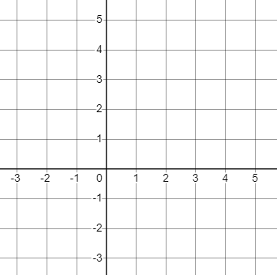



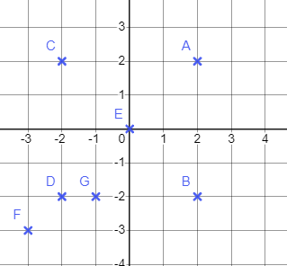




Plotting coordinates generated from a rule
Task C: Plotting coordinates that follow a rule
Plot all the integer points that satisfy each rule.
a) The x value is 1
b) The y value is one less than the x value
c) The y value is double the x value
Describe the pattern
Describe the pattern
Describe the pattern
d)
e)
f)
Describe the pattern
Describe the pattern
Describe the pattern
2) The grid shows seven points labelled A, B, C, D, E, F and G. Complete the table to show which points have coordinates that match the rules below. The first column has been completed for you.
Rule | A | B | C | D | E | F | G
 | yes
 | no
 | yes
 | no
Mathematics in Education and Industry
v2.1

